Slide 1
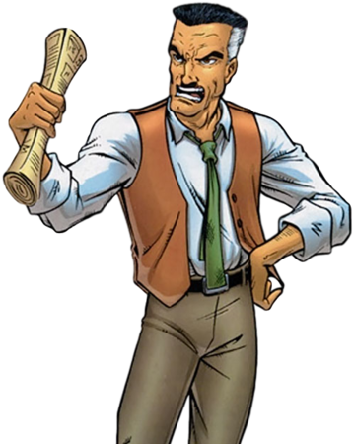
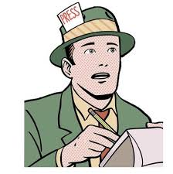


EDITOR
Receives news from Reporter
Forwards it to Sub Editor for editing
- Receives the edited news - Approves or rejects the news report
REPORTER
- Submits news reports
SUB EDITOR
- Receives news from Editor
- Edits news report - Sends it back for approval

